Slide 1
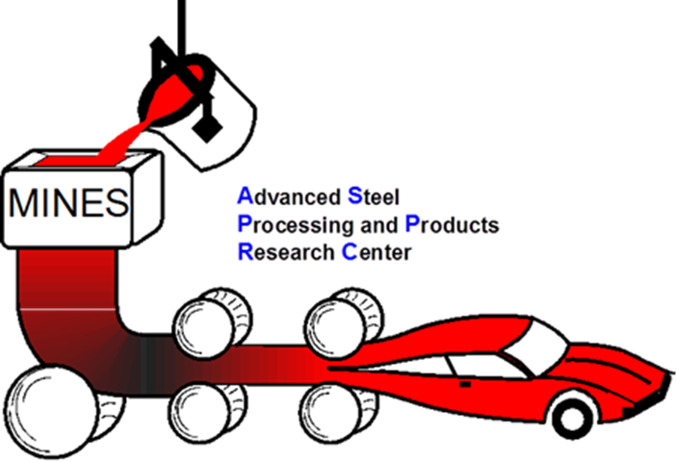

Robert Goldstein,
Fluxtrol, Inc. rcgoldstein@fluxtrol.com
Ethan Buchner, Robert Cryderman
Colorado School of Mines, Golden, Colorado
Modeling of Short Time Dilatometry Testing of High Carbon Steels

Slide 2
Overview
Effect of Short Time Heat Treatment on Transformation Phenomena
  Test Results That Led to the Study
Dilatometer Description
Modeling Dilatometer Performance
Comparison Between Simulation and Experiments
Conclusions/Future Research

Slide 3
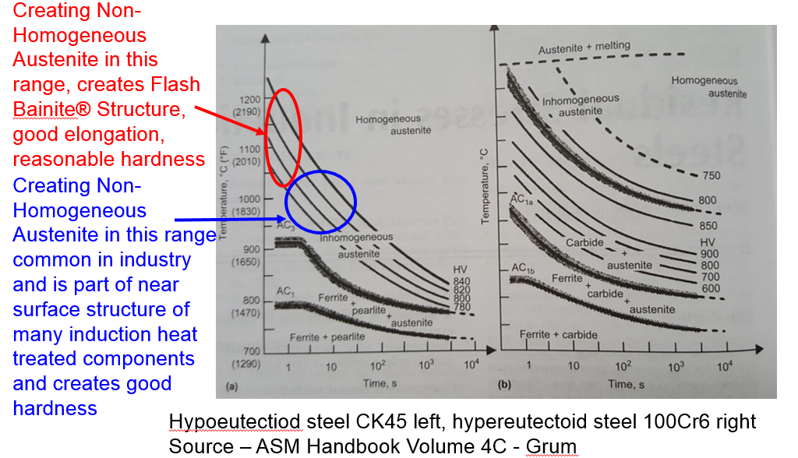
Effect of Short Time Heat Treatment on Transformation Temperature
Superior Performance of Components Has Been Achieved in Many Cases Using Non-Equilibrium Thermal Processes (NETP), but There Is Very Little Quantitative Data Available on Material Response to Rapid Thermal Processing

Slide 4
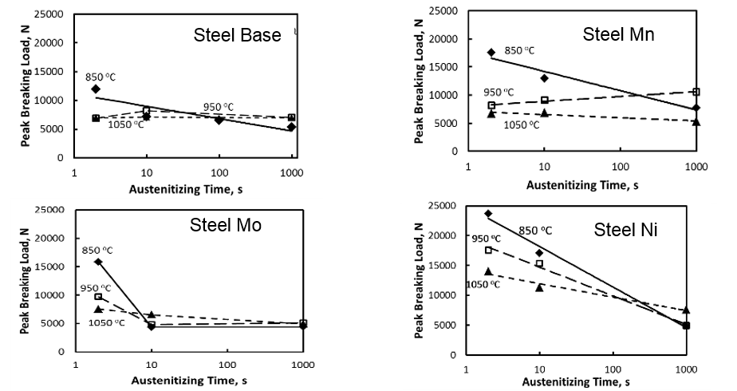
Recent Findings at ASPPRC of Improved Mechanical Properties with NETP
Up to 3X better properties demonstrated using appropriate alloying elements and relatively short, low temperature heat treatment

Slide 5
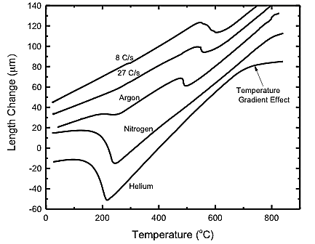
Dilatometer Testing of the Steel for Materials Characterization
Effect of Reduced Pre-Transformation Expansion with Increasing Cooling Rate called Temperature Gradient Effect and Led to Impression There Was Non-Uniform Temperature in the Sample
Cooling Rates:
  He: 235 ˚C/s
  N: 91 ˚C/s
  Ar: 52 ˚C/s

Slide 6
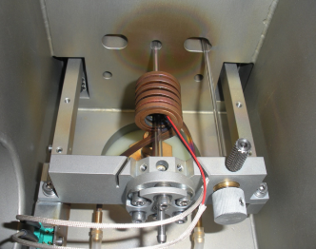
Dilatometer Description
Measures dimensional movement during thermal procession
Heating is in a vacuum
Heat source is induction heating
  Advertised heating rate up to 1000 C/s
Gas quenching through induction coil used for cooling
Fused silica rods hold the component
Manufacturer TA Instruments

Slide 7
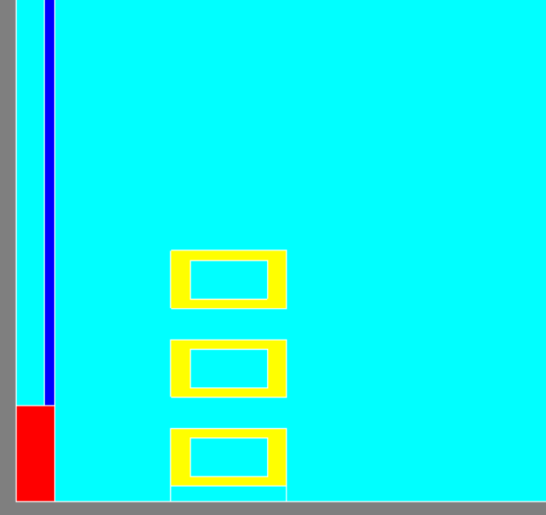
Modeling of Dilatometer Tests
Heating and Cooling simulations separated due to differences in enthalpy of phase transformations
1 D Program ELTA used initially to determine radial gradients and inverse calculations of material properties
2D Program Flux Used for Determining Full Temperature Distributions
For Flux – ½ of axisymmetric system used

Slide 8
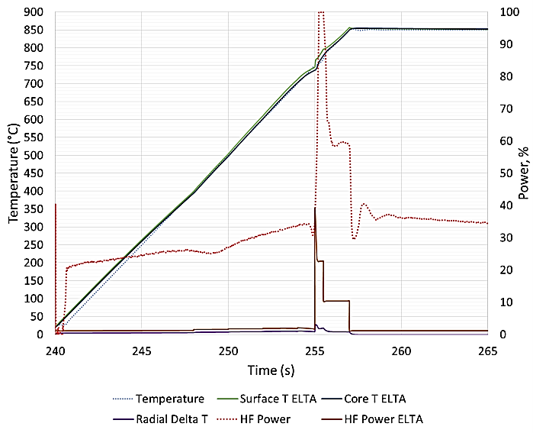
Comparison of ELTA with Experimental Data
Surface Temperature tracks closely
Dynamics of power change very similar
Big discrepancy in power level, measured substantially higher than calculated

Slide 9
Radial Temperature Gradients for Different Heating Rates with Helium Quench
For 50 CPS, radial gradients much larger during cooling than heating. As heating rate increases, gradients during initial heating approach those from the rapid cooling. After Curie Point, radial temperature difference close to 0 for all samples during heating and holding phase

Slide 10
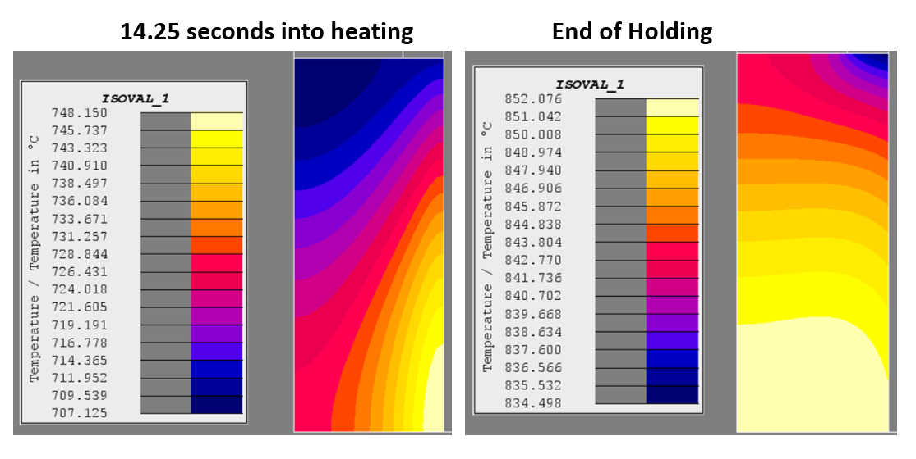
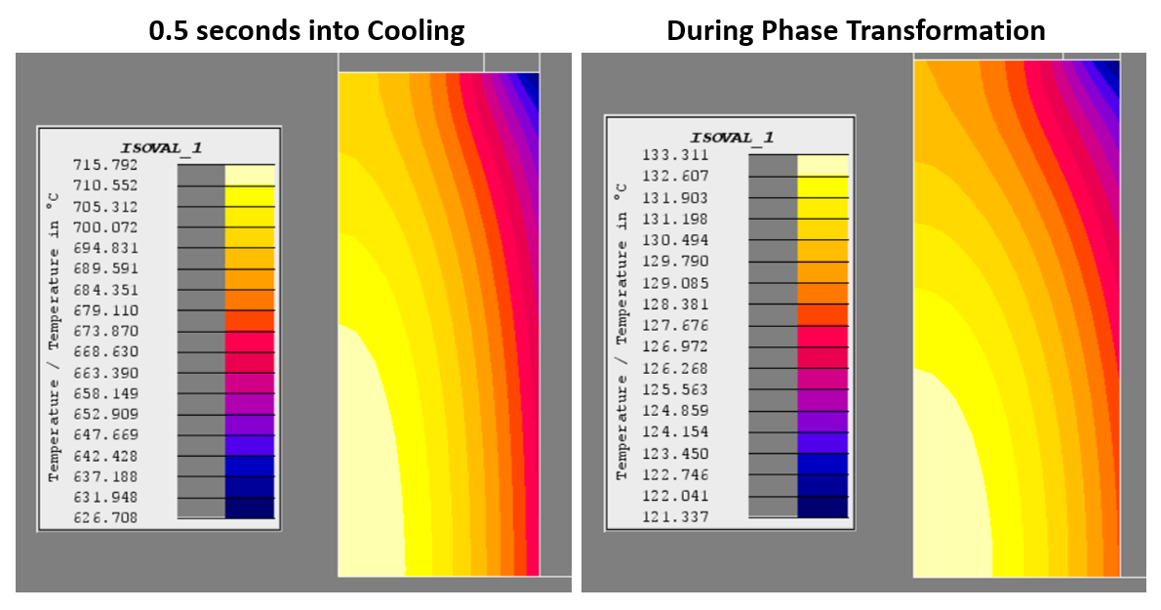
2D Modeling with Flux
Axial Gradients are Larger than Radial Gradients on Heating According to Models
Axial Gradients Also Exist on Cooling, with ends being colder than center for uniform heat transfer coefficient on surface

Slide 11
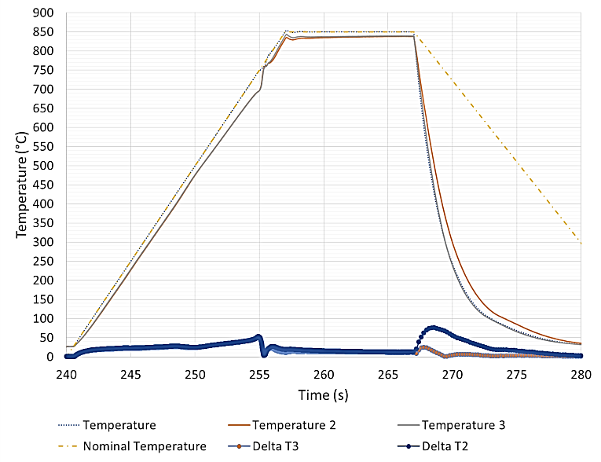
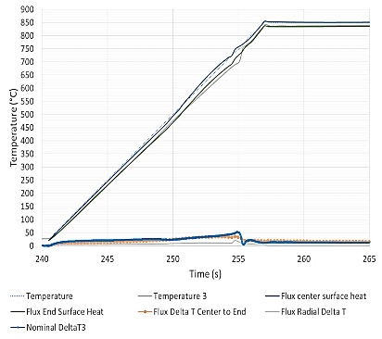
3 TC Testing and Comparison to Models Heating
Experiments
Models

Slide 12
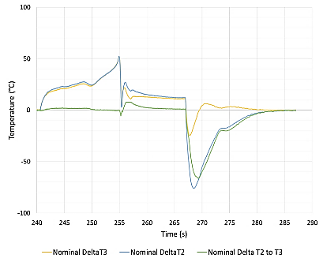
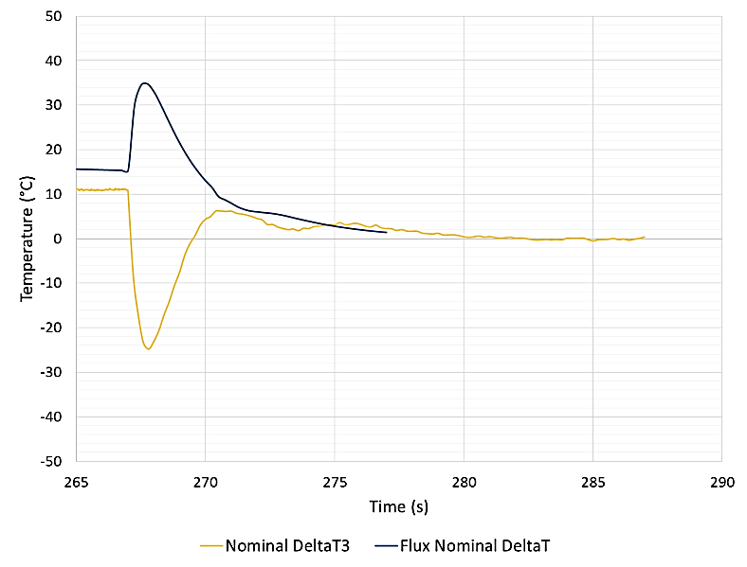
3 TC Testing Cooling Comparison
Experimental End to End
Experimental Cool End to Models
Excellent Agreement
During Heating
Cool End
Initial Inversion of Gradient Compared to Models
Hot End
Axial Variation in Temperature is High, End to End Cooling Different, Initial Inversion Relative to Models Means We Have Significant HTC Variation in Length and Time!

Slide 13
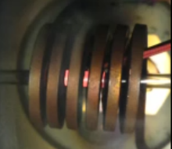
Image During Cooling
Hot End
Cool End

Slide 14
Conclusions
Models have been created to determine temperature distributions which occur during dilatometer testing
Once the steel started transforming from magnetic to non-magnetic, the generator power level rises dramatically, limiting the ability to deliver high heating rates
  Need to understand better as there is a significant variance from calculated power levels and need to determine how to increase power delivery
For rapid heating and cooling rates, there are significant gradients (both axial and radial) in the part which need to be considered when evaluating dimensional movement data
More work still needs to be done to better characterize/improve the cooling dynamics in the system

